Slide 1


Maximizing your social security retirement benefits
The information contained herein has been obtained from sources considered reliable, but we do not guarantee that the foregoing is accurate or complete.
©2017 Raymond James & Associates, Inc., member New York Stock Exchange/SIPC ©2017 Raymond James Financial Services, Inc., member FINRA/SIPC
Investment products are: not deposits, not FDIC/NCUA insured, not insured by any government agency, not bank guaranteed, subject to risk and may lose value.
Raymond James® is a registered trademark of Raymond James Financial, Inc.
Notes:
Welcome everyone and thank you for joining us today. The goal of this presentation is to give you a better understanding of how Social Security retirement benefits work so you can make an informed decision when you become eligible to receive benefits.

Slide 2



When to start collecting benefits?
An important decision with lifetime consequences
Social Security is a complex and evolving program
Be informed and make a prudent decision
Notes:
Deciding when to collect Social Security benefits will be one of the most important financial decisions you make. The decision you make has lifetime consequences for you and your spouse, so it’s essential to understand all your options and make a prudent decision. Because Social Security is a complex program with over 2,700 rules that are subject to change, many individuals miss out on thousands of dollars in benefits because they are not aware of certain claiming strategies they can use to their advantage. Do not expect or rely on the Social Security Administration to give you personalized guidance on your situation. Each client’s situation is unique and you should work with a financial professional to ensure you make the decision that is best for you and your family. I don’t have all the 2,700 rules memorized, but I do have a team of experts and access to sophisticated resources that can help you help you evaluate all options for your unique situation.

Slide 3
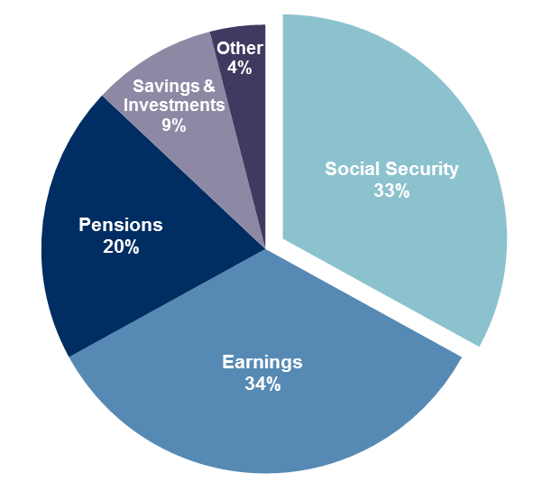
Retirement income Sources
Source: Fast Facts & Figures about Social Security, 2015
Notes:
For the majority of retired Americans, Social Security is the primary source of retirement income. Ideally, you should have a variety of income sources to rely on during retirement and Social Security should be a slice of the pie. However, even if you have an adequate amount of retirement savings or are lucky enough to have a pension, Social Security retirement benefits offer advantages that many other forms of retirement income do not. Today we will review many of those advantages so you are aware of how important Social Security can be to your retirement income plan.

Slide 4







Advantages of Social Security
Lifetime income &
Longevity insurance
Government backed
Annual Inflation Adjustments
Preferential Tax Treatment
Survivor Benefits
Steady stream of monthly income
Notes:
The more you understand about Social Security benefits, the more you will realize it is a great retirement income source. This slide highlights some of the main advantages Social Security offers and we will discuss these throughout the presentation.

Slide 5

social security solvency
Social Security Old-Age and Survivors Insurance and Disability Insurance trust funds are projected to meet funding needs through 2034.
After 2034, payroll taxes are projected to pay about 79% of benefits through 2089.
Future reform is likely
Fears of Social Security reducing benefits should not influence your claiming decision
Source: Fast Facts & Figures about Social Security, 2015
Notes:
One topic that I would like to address early on is the future of Social Security, which might be a concern for many of you. It is estimated that if no reforms are made, Social Security has adequate funds to meet 100% of payable benefits through 2034, then 79% of benefits payable through 2089. With so many Americans reliant on Social Security benefits, it is likely there will be future reform so benefits can be fully paid. Changes were even made in late 2015 that eliminated certain strategies for spouses. We’ll discuss these changes later in the presentation. The main point is that you should not base your decision on the belief that Social Security is going broke and nothing will be done to keep it funded.

Slide 6
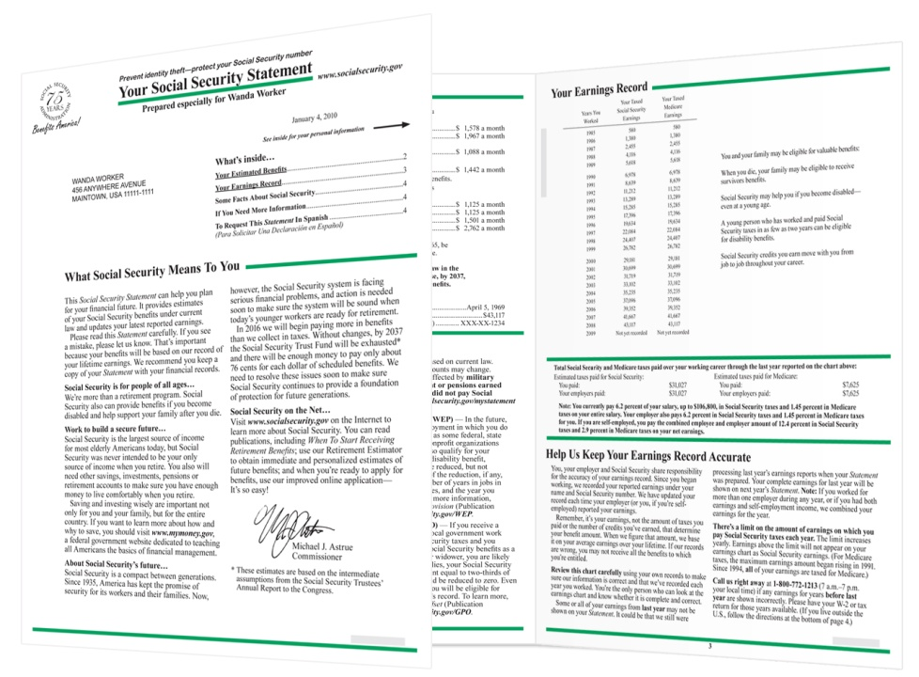

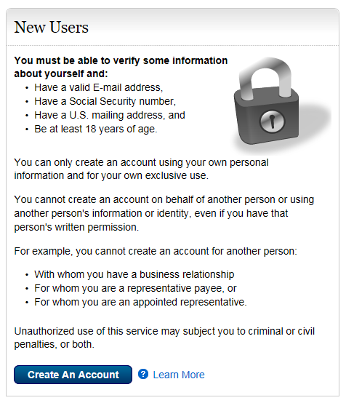
Your social security account
Notes:
If you have not done so already, I strongly encourage everyone to go online and establish a my Social Security account so you can become familiar with your personalized benefits statement. It’s also important to establish an online account to prevent fraudsters from establishing one under your identity, which can be a major headache. Throughout today’s presentation, we will highlight and explain different items you will find on your benefits statement.

Slide 7
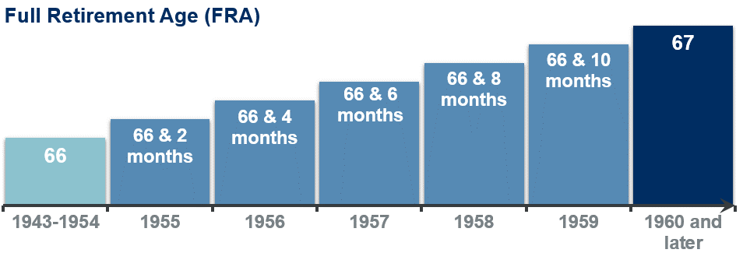
Terms to know
Primary Insurance Amount (PIA)
Monthly benefit you are eligible to collect at your full retirement age (FRA)
Determined by your 35 highest earning years
2018 Max PIA = $2,788 per month
Notes:
Let’s get started with some Social Security basics and discuss some terms we will mention throughout the presentation. The first term to get familiar with is your Primary Insurance Amount or PIA. This is the monthly amount you are eligible to start collecting at your Full Retirement Age (FRA). Your PIA is calculated based on your 35 highest earning years. The higher your 35 highest earning years, the higher your PIA. If you have less than 35 years of earnings, zero’s are filled in which will lower your PIA. If you have less than 35 years of work or some years with very low earnings compared to what your currently make, you can increase your PIA by continued work.
Your Full Retirement Age or FRA, is a key milestone when it comes to Social Security. As you can see on this chart, it is based on the year you were born and should be somewhere between age 66 and 67. Your FRA is when you can collect your full PIA amount, but it also has other implications that we will talk about throughout the presentation. Do not take the term Full Retirement Age too literally, because it does not determine when you should or could retire. There are many other factors aside from Social Security that influence when you truly should or could retire.

Slide 8
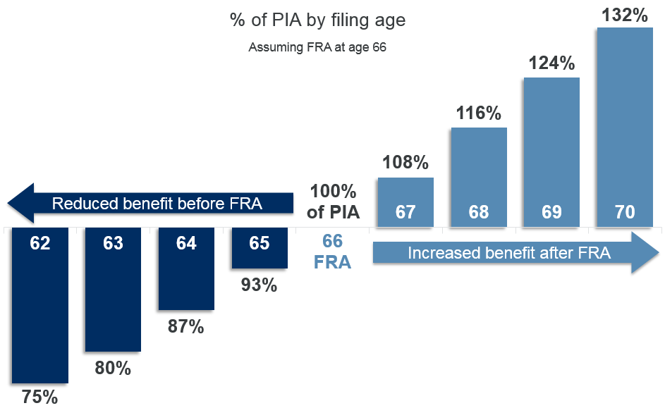
Early vs. delayed Filing
Source: SSA.gov
Notes:
You do not have to wait until your FRA to start collecting benefits. You can claim benefits as early as age 62 (and sometimes earlier for certain situations) or as late as age 70.
If you claim benefits prior to your FRA, you will have a permanent reduction in your lifetime benefit amount. For someone who’s FRA is 66 starts collecting benefits when first eligible at age 62, they will only receive 75% of their PIA which is a 25% reduction. If your FRA is 67, you would only receive 70% of your PIA amount at age 62.
Conversely, if you decide to delay collecting benefits past your FRA, you will receive an 8% annual increase from your PIA amount until age 70, which could be as high as 132% of your PIA if FRA is 66, or 124% if your FRA is 67.

Slide 9
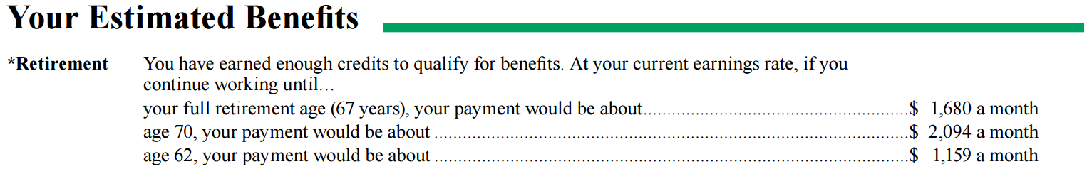
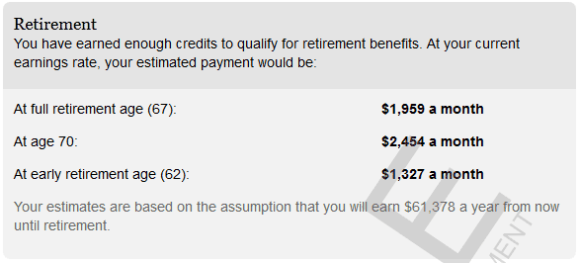
Your Benefits Information
Notes:
Your benefits statement and online account will show your FRA and an estimate of how much your are eligible to collect at age 62, FRA, and age 70.

Slide 10
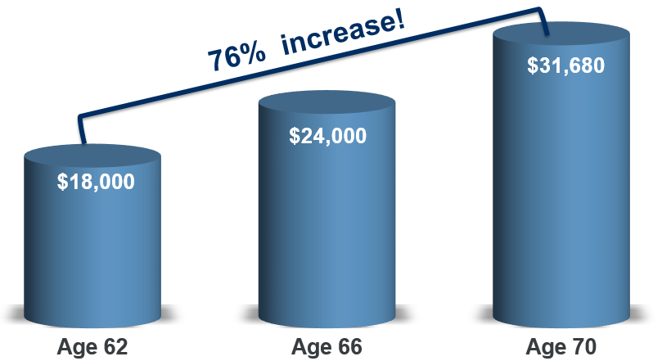
Early vs. delayed claiming
FRA at age 66
PIA = $2,000 per month
$24,000 annually
Notes:
To see how big of an impact your claiming age can make in dollar terms, lets take a look at a simple example. An individual with a PIA of $2,000 per month or $24,000 per year at their FRA of 66, would receive $6,000 less per year if they claimed at age 62. If they waited till age 70, they would receive $7,680 more per year over their FRA amount, and $13,680 more per year vs claiming at 62. So as you can see, the age you decide to claim benefits, can have a significant impact on your annual retirement income.

Slide 11
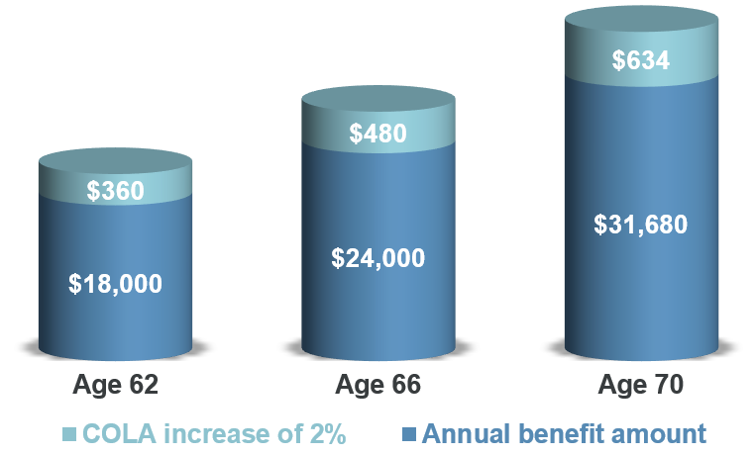
Cost of Living Adjustments (COLA)
Annual inflation adjustment to Social Security benefits
All recipients receive the same COLA % increase, but those with higher benefits receive a larger dollar increase.
Notes:
A nice advantage of Social Security retirement benefits are Cost of Living Adjustments or COLAs. A COLA is an annual inflation adjustment to your benefit amount, which is based on the increase in the Consumer Price Index-W. These annual adjustments help you maintain the purchasing power of your benefits and keep up with the price inflation of goods and services. While all recipients of Social Security receive the same annual COLA % increase, those with a larger benefit amount will receive a larger dollar increase. As you can see here, a COLA of 2% is much more at age 70 vs 62 and these COLAs can really add up over time as well. To clarify, you do not have to claim benefits to receive a COLA, they are factored into your benefits even if you have not claimed yet.

Slide 12
working and receiving benefits
Under FRA for the full year
$1 of benefits withheld for every $2 in earnings above $17,040
Year individual reaches FRA
$1 of benefits withheld for every $3 in earnings above $45,360
Month of FRA and beyond
No earnings limit and withheld benefits are paid back monthly
Notes:
If you claim benefits prior to your FRA and you are still working, Social Security could actually withhold a portion, or even all of your benefits! It depends on if your earnings exceed certain thresholds.
For years prior to FRA, if you earn more than the earnings limit of ($17,040 in 2018), you will have $1 of benefits withheld for every $2 earned over that threshold.
For the year in which you reach full retirement age, a higher earning limit of ($45,360 in 2018) applies and you will have $1 in benefits withheld for every $3 in earnings over the threshold.
If you have benefits withheld, Social Security adjusts your benefit amount at full retirement age to start paying you back for the amount that was withheld on a monthly basis. It is a common misconception that the benefits are permanently lost when withheld due to the earnings test; they are not. It is basically a forced suspension of benefits”.
As you can see, claiming early if you are still working is not always a good decision, especially if you will have a large portion of your benefits withheld.

Slide 13

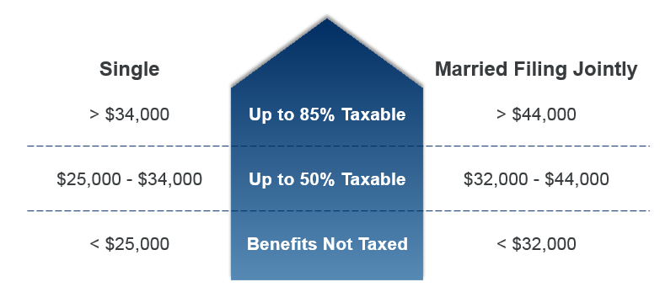
Taxation of social security benefits
Taxation of benefits is determined by your provisional income
Up to 85% of benefits can be taxed
Notes:
Taxation of Social Security benefits depends your Provisional Income, see the calculation here. For the most part, your provisional income includes all sources of income you have except for Roth IRA or Roth 401K withdrawals, withdrawals from cash balance life insurance, and certain types of deferred annuity income. If you notice, only half of your Social Security benefits are included in your provisional income, making it a more favorable source of income from a tax perspective and I’ll explain why.
If your provisional income falls below the first threshold on this chart, your benefits are tax-free, which is a good deal.
If your provisional income exceeds the first threshold, up to 50% of your benefits could be taxed.
And if your provisional income exceed the 2rd threshold up to 85% of your benefits could be taxed.
However, even if you exceed one of these thresholds, it does not mean your benefits are instantly taxed at 50% or 85%.
Social Security income is tax-efficient in two ways:
Only half of benefits are counted in your provisional income
At most, 85% of benefits are taxed which is still better than many other forms of income which are fully taxed(like traditional IRA’s, earnings, taxable bond interest)
To relieve the burden of having to pay out taxes on April 15, you may opt to have income taxes withheld from your Social Security benefits throughout the year.

Slide 14
If you have a government pension
Government Pension Offset (GPO)
  2/3 of what you receive from your government pension will be subtracted from your Social Security benefit
  Affects spousal and survivor benefits
Windfall Elimination Provision (WEP)
  If you receive a pension from an employer who did not withhold Social Security taxes from your pay, your Social Security benefit can be reduced up to 50%
Notes:
Were you or your spouse a federal, state, or local government employee at some time?
If so, it is possible that certain downward adjustments will be made to your Social Security benefits. If the government entity you or your spouse worked for did not participate in the Social Security system, these adjustments will most likely apply to you. We won’t spend a lot of time on them today because they are fairly rare. But just know that if these adjustments may apply to you, seek guidance from your financial professional.

Slide 15
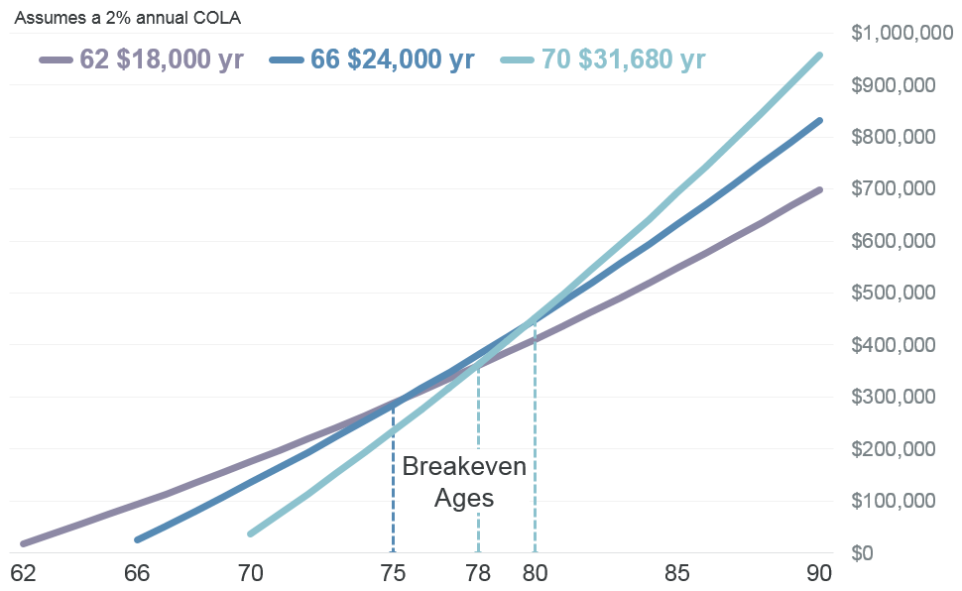
Cumulative Benefits over time
Month of FRA and beyond
Notes:
If some of you are thinking, well of course you get a higher benefit if you delay, because you’ll miss out on getting payments sooner. Let’s take a look at how benefits add up over time based on different claiming ages.
I’d like to highlight a few items on this chart starting with the dotted lines.
-The first dotted line at age 75 is when total benefits for claiming at age 66 surpass claiming at 62,
-the second line at age 78 is when claiming at age 70 surpasses claiming at age 62,
-and the third dotted line is when claiming at age 70 surpasses claiming at age 66.
After age 80, the differences get larger and larger each year, and by age 90 the difference in lifetime benefits is hundreds of thousands!
This is just one example and breakeven ages will vary based on many factors.

Slide 16
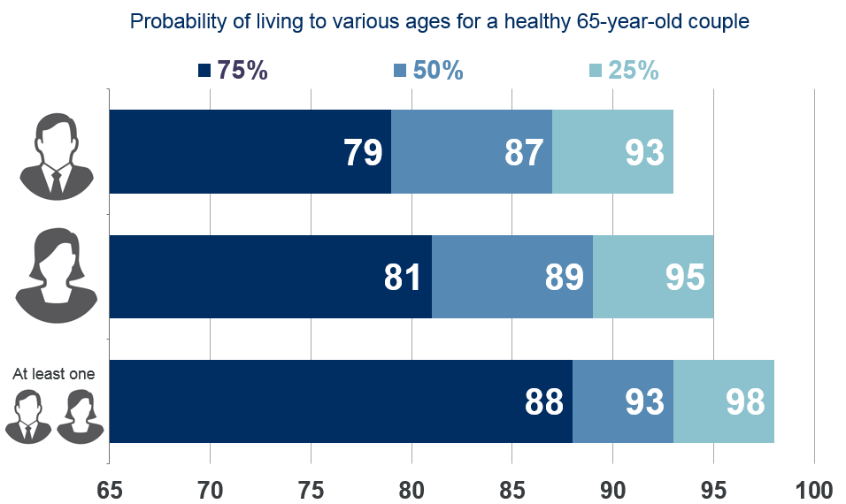
Longevity
SOA RP2014 healthy annuitant rates
Notes:
After looking at the previous chart, let’s take a moment to discuss longevity and how long your retirement could potentially be. We have on this slide life expectancy for a healthy 65 year old couple. There is a 75% chance that at least one person will live till age 88, which is pretty high odds. If you remember from the previous slide some of the breakeven ages were much lower than age 88. People are living longer than ever and the need for lifetime income is significant for retirees. Funding a long retirement can be extremely expensive and unless you have a pension, Social Security may be the only form of income source that pays you for life.

Slide 17


Spousal benefits
Married individuals can collect Social Security benefits on their spouse’s earning record if:
  Married for at least one year
  At least age 62
  The other spouse has started collecting their individual benefits
Once the higher earner starts collecting individual benefits
Max spousal benefit at FRA
Spousal benefits as early as age 62
50% of Spouses PIA
Monthly increases for delayed claiming
35% of Spouses PIA
Notes:
Let’s transition now to Social Security for married couples. This is where things can get a little more complex but the concepts are extremely important to understand so you do not overlook any options that are available to you
Spousal benefits are valuable for couples if one spouse does not qualify for individual benefits, if they have a much lower PIA amount (less than 50% of the higher earners PIA) or if restricted application is an option, which we will discuss in more detail later.
Married individuals are eligible to claim spousal benefits, which are benefits based on the other spouse’s earnings history, if:
-they have been married for at least one year
-at least age 62
-And most importantly, the spouse whose earning record is being collected on, must have started receiving their individual Social Security benefits
The maximum spousal benefit that can be received is 50% of the other spouse’s PIA amount, which is achieved by waiting until FRA to collect spousal benefits. Spousal benefits can be available as early as age 62 but will be reduced for each month prior to FRA. The minimum spousal amount at age 62 is 32.5% (FRA 67) - 35% (FRA66) of the other spouses PIA.

Slide 18


Divorced spousal Benefits
A divorced spouse can receive benefits on an ex-spouse’s earnings record if:
Married for at least 10 years
Divorced for at least 2 years
Currently unmarried
At least age 62
Claim is confidential
Notes:
Did you know you can receive spousal benefits on an ex-spouse if:
-you had a marriage that lasted at least 10 years
-you have been divorced for at least 2 years (unless your ex-spouse had already filed for benefits at the time of divorce; in that case, you do not need to wait two years)
-you are currently unmarried
And if you have been divorced a few times you can even choose what ex-spouse earnings history to claim benefits on.
Divorced spousal benefits work similar to regular spousal benefits, but one advantage is not having to wait for the ex-spouse to claim individual benefits first.

Slide 19

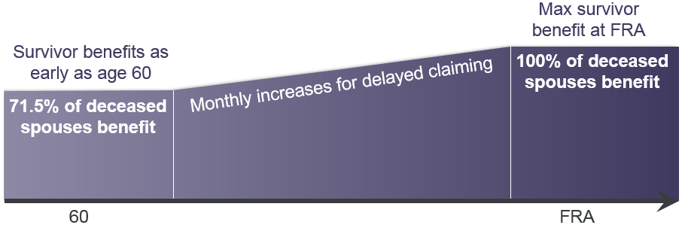
Survivor benefits
A surviving spouse can receive the deceased spouse’s benefit if:
Married for at least 9 months
At least 60 years old, unless disabled or caring for deceased spouses child
100% of deceased spouses benefit
Monthly increases for delayed claiming
71.5% of deceased spouses benefit
Notes:
Survivor benefits are extremely valuable if the lower earning spouse survives the higher earning spouse.
A widow(er) may receive survivor benefits as early as age 60 or prior if he or she has a child under age 16 or disabled.
Full survivor benefits are available at FRA, and are equal to either 100% of benefit they were receiving or eligible to receive at death. If survivor benefits are claimed prior to the surviving spouses FRA, a monthly reduction applies. At age 60, minimum amount equal to 71.5% of deceased spouses benefit can be claimed.
Should the widow(er) remarry, the Social Security benefit for the widow(er) may terminate – but the benefit for the eligible child will not.
If surviving spouse is eligible for their own benefits, there can be opportunities to:
-claim survivor benefits and let their individual benefit grow to age 70
-or claim individual benefits early and claim full survivor benefit at FRA
Survivor benefits are available to a divorced spouse unless remarriage occurred before age 60. As with a divorced spouse retirement benefits, the marriage must have lasted 10 years.

Slide 20


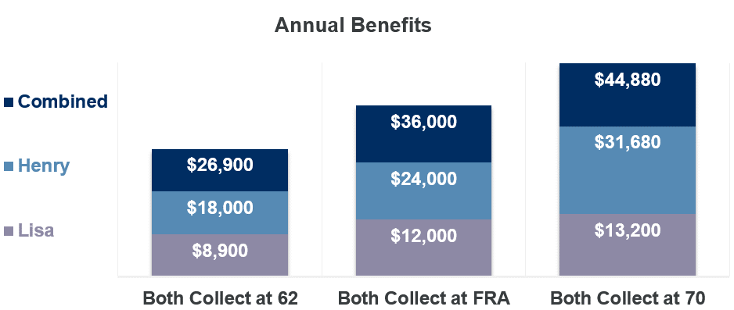
Married Couple example
Lisa Lower Earner
Henry High Earner
PIA = $833
$10,000/yr
PIA = $2,000
$24,000/yr
Lisa claims survivor benefits
Lisa receives excess
spousal benefits
Lisa claims reduced individual benefits
Notes:
To better understand spousal benefit and survivor benefits, let’s take a look at a case involving a married couple.
-Lisa has a PIA of $833 per month or $10K per yr
-Henry has a PIA of $2,000 per month or $24,000 per yr
To keep things simple, they both are the same age and their full retirement age is 66.
This chart illustrates what their benefit amounts are if they both collect benefits at age 62, 66(FRA), and 70. One thing I would like to specifically point out is that because Henry has a much higher PIA, Lisa is collecting 50% of Henry’s PIA since it’s higher than her individual benefit. Henry also receives a significantly higher dollar amount for delaying his benefits compared to Lisa. Also note, that if Lisa survives Henry, she can step up to his benefit amount and collect survivor benefits. So in this case, it is more important for Henry to delay benefits as long as possible than it is for Lisa.
So let’s see what it would look like if Lisa collects benefits before Henry.

Slide 21
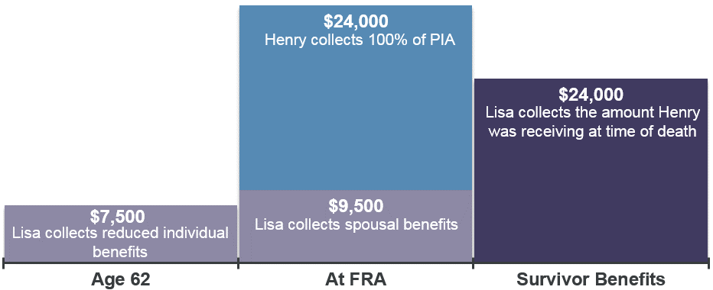
Married Couple example
Lisa Lower Earner
Henry High Earner
PIA = $833
$10,000/yr
PIA = $2,000
$24,000/yr
Henry claims full PIA at FRA
Lisa claims survivor benefits
Lisa receives excess
spousal benefits
Lisa collects reduced individual benefits
Notes:
In this example, Lisa collects as soon as she is eligible at age 62, and will receive 75% of her PIA, or $7,500/yr. Henry then collects at FRA(66), and receives his full PIA. When Henry starts collecting his benefits, this allows Lisa to get a spousal benefit increase. Then if Lisa survives Henry, she can step up into the benefit Henry was entitled to.

Slide 22
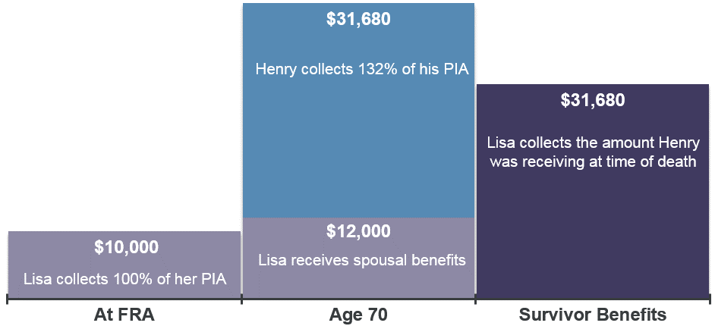
Married couple example
Lisa Lower Earner
Henry High Earner
PIA = $833
$10,000/yr
PIA = $2,000
$24,000/yr
Notes:
This example is similar, but it shows Lisa collecting at FRA and Henry collecting at age 70. The main difference here is Henry’s benefit amount and Lisa’s survivor benefit is much higher.

Slide 23
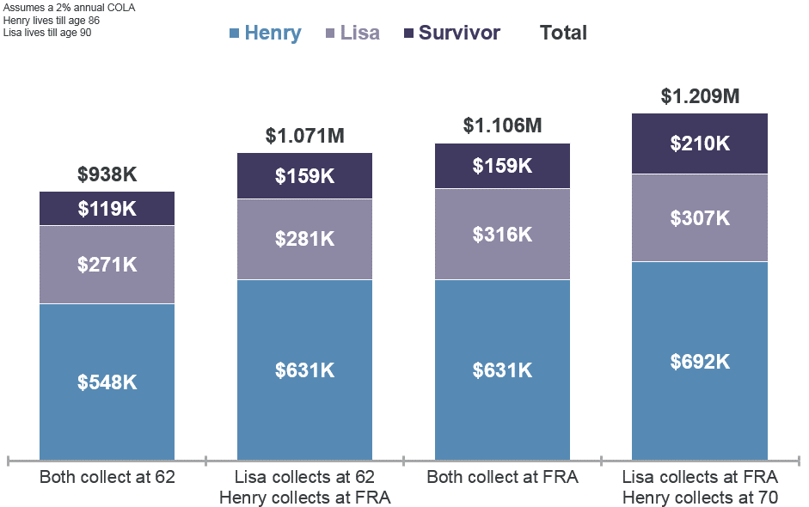
Cumulative Lifetime Benefits
Henry claims full PIA at FRA
Lisa claims survivor benefits
Notes:
So what strategy yields the highest amount of lifetime benefits for Henry and Lisa? Well it really depends on how long they each live. If we assume that Henry lives until age 86 and Lisa lives until age 90 and they will receive a 2% COLA each year, we get the following results. You can see that if Lisa collects at FRA and Henry collects at age 70, they receive over $1.2M in combined benefits and it also maximizes the amount Lisa receives if she survives Henry.

Slide 24
Age 62 before 2016?
The Bipartisan Budget Act of 2015 resulted in the elimination of two popular claiming strategies that were previously available to married couples.
If you turned age 62 prior to 2016, you still have the ability to file a Restricted Application, which allows you to claim a spousal benefit first, while your individual benefit earns delayed credits.
Notes:
In 2015, Congress eliminated two strategies that married individuals could use to increase their benefits. However if anyone turned 62 prior to 2016, you still have access to a strategy known as Restricted Application.

Slide 25
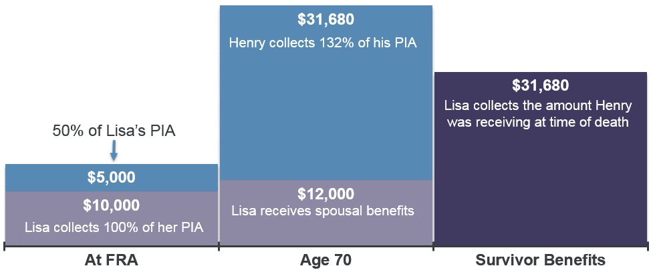
Restricted Application
Lisa Lower Earner
Henry High Earner
PIA = $833
$10,000/yr
PIA = $2,000
$24,000/yr
Henry collects 132% of his PIA
Lisa collects the amount Henry was receiving at time of death
Lisa receives spousal benefits
Lisa collects 100% of her PIA
Notes:
Let’s go back to Henry and Lisa to show an example of Restricted Application.
Restricted application allows both Henry and Lisa to receive spousal benefits. In this example, Lisa collects her full PIA at FRA, which then allows Henry to collect 50% of Lisa’s PIA until he collects his maximum benefit amount at age 70. This allows Henry to collect an additional $20,000 in spousal benefits before he starts receiving his individual benefits.

Slide 26




Questions to consider
      Work
        When do you plan to stop working?
        What will your earnings look like until retirement?
      Longevity
        How is your health?
        Family history of longevity?
      Spouse
        What benefit amount is your spouse eligible for?
        Spouse’s health and longevity?
        What is the age difference between you and your spouse?
      Retirement Income
        What other sources of retirement income do you have?
        How important is Social Security to your retirement income?
Notes:
I know we have reviewed a lot of information, so let’s take a step back and review some questions you should ask yourself when developing a plan for collecting Social Security.
[highlight a couple key questions from slide]

Slide 27
General Claiming guidelines
Before FRA
FRA or later
FRA
Lower life expectancy
Lower earning & younger spouse
Strong need for income
Fully retired and no earnings
Survivor benefits
Disabled
Generally a best practice
Longer life expectancy
Higher earner with lower earning younger spouse
Still working or access other sources of income to meet expenses
Maximize a large spousal benefit
Notes:
[highlight key bullets from slide]

Slide 28
Next steps
Go to www.ssa.gov/myaccount
to establish your online account and review your benefits information
Evaluate different claiming scenarios based on your personal situation
Develop and implement a comprehensive retirement income plan
Raymond James has the tools, resources and
expertise to help you understand the decisions you face.
The information herein has been obtained from sources considered to be reliable, but we do not guarantee that the foregoing material is accurate or complete. This information is not a complete summary or statement of all available data necessary for making a decision and does not constitute a recommendation. You should discuss any tax or legal matters with the appropriate professional.

